Slide 1
UK Biobank Interaction Analysis Plan
Joanna Lin, Kenny Westerman, Magdalena Sevilla, Beza Tadess

Slide 2
Background
Epidemiological research has found multiple risk factors of COVID-19 severity.
Sex: Male sex is independently associated with higher mortality and worse outcomes of COVID-19 (Palaiodimos et al., 2020)
Cardiometabolic status: Obesity and T2D are associated with increased COVID-19 susceptibility and severity. Obesity is specifically highlighted as potentially causal with COVID-19 via MR methods, perhaps mediated through T2D (Leong et al., 2020).
Social determinants of health: Minority communities have disproportionately worse outcomes of COVID-19, and may be predisposed to worse conditions due to environmental factors, limited healthcare access, and other societal factors (Tai et al., 2020)
Notes:
Palaiodimos: https://www.ncbi.nlm.nih.gov/pmc/articles/PMC7228874/
Leong: https://www.medrxiv.org/content/10.1101/2020.08.26.20182709v1.full.pdf+html
Tai: https://academic.oup.com/cid/advance-article/doi/10.1093/cid/ciaa815/5860249#207274256
Other studies:
Sex-bias in COVID-19 association: thelancet.com/journals/eclinm/article/PIIS2589-5370(20)30263-7/fulltext
Biological sex impacts COVID-19 : https://journals.plos.org/plospathogens/article?id=10.1371/journal.ppat.1008570
SDH and COVID-19: https://onlinelibrary.wiley.com/doi/full/10.1111/1475-5890.12232
Temperature and Race: https://www.sciencedirect.com/science/article/pii/S0002962920302573
T2D and COVID (Seiglie 2020) https://care-diabetesjournals-org.ezp-prod1.hul.harvard.edu/content/early/2020/08/24/dc20-1506.long
Results of a nationwide analysis in England showed that type 1 and type 2 diabetes were both independently associated with a significant increased odds of in-hospital death with COVID-19. (Barron 2020) https://pubmed.ncbi.nlm.nih.gov/32798472/
Increased COVID-19-related mortality was associated not only with cardiovascular and renal complications of diabetes but, independently, also with glycaemic control and BMI.
https://pubmed.ncbi.nlm.nih.gov/32798471/
T2DM patients showed higher inflammatory response to COVID 19 with higher absolute neutrophilic count (ANC) and CRP with lower lymphocytic and eosinophilic counts. Diabetic patients had more comorbidities and more aggressive course of the disease with higher rate of ICU admission and longer need for hospitalization and oxygen use. (Soliman, 2020)
https://pubmed.ncbi.nlm.nih.gov/32921708/

Slide 3
Background
Genetic investigations, such as the Host Genetics Initiative, have started to uncover genetic underpinnings of COVID severity.
COVID19-hg GWAS meta-analyses Round 3 released July 2nd
UKB, FinnGen, DECODE, Partners Healthcare Biobank + more!

Slide 4
Preliminary Data
Joanna’s MR results
Significant causality between obesity and COVID-19 severity
Significant genetic heterogeneity in testing sex stratified BMI and COVID-19 severity
Andrew’s preliminary UKB interaction analysis
Interesting suggestive interaction loci with T2D and COVID lethality
Biological plausibility that we want to further explore

Slide 5
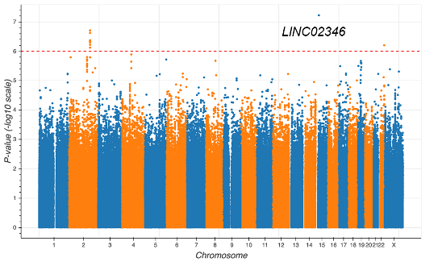
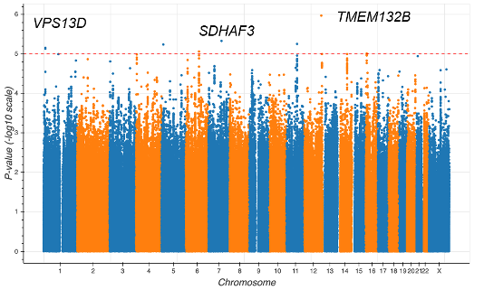
Preliminary Data (GxE for T2D)
Interaction Test (6 loci with p < 1e-5)
Joint Test (3 loci with p < 1e-6)
Test of the interaction effect of T2D on the association between variant and COVID-19 associated death
Test of the association between variant and COVID associated death allowing for T2D Interaction
Andrew De Pass
Notes:
Potential effect alleles identified in interaction test and joint test
LINC02346 and TMEM132B associated with nervous system function
VPS13D and SDHAF3 associated with mitochondrial function

Slide 6
Objective
Conduct a large scale genome-wide interaction study in the UK Biobank to investigate the interaction between genetic variants and each of sex, obesity, T2D and social determinants of health in their impact on COVID-19 severity.
Hypothesis
Primary Hypothesis: There are genetic variants that modify the effect of known COVID-19 risk factors on COVID-19 severity (and vice versa).
Secondary Hypothesis: Incorporation of known COVID-19 risk factor interactions via a joint test can increase the power to uncover genetic loci associated with COVID-19 severity.
Notes:
These findings in previous studies motivate us to

Slide 7
Dataset
Population: All unrelated individuals in UKB (that haven’t revoked consent)
Multi-ancestry (European, West African, East Asian, and South Asian)
Sample sizes depend on COVID-19 outcomes availability
Genotypes: Largely rely on the processing already performed by the UKB group
Marker-level: Batch/plate/sex/array effect marker removal and HWE
Sample-level: High heterozygosity and >5% missingness
Common variants (MAF > 0.01)

Slide 8
Exposures of Interest
Genetically-determined sex
Cardiometabolic diseases
Obesity as measured by BMI
T2D (existing definition derived within the Florez lab UKB project)
Social determinants of health
Multiple deprivation index, composed of metrics including:
Economic stability
Physical environment
Education
Notes:
Economic stability (employment/income)
Physical environment (housing, walkability, safety, and transportation)
Education (literacy and higher education)

Slide 9
Outcomes
COVID-19 severity defined as hospitalization
Similar to Host Genetics Initiative: B2-Phenotype - Hospitalized COVID vs population
Secondary outcomes:
Susceptibility: COVID-19 by RNA PCR, serologic testing, or clinician diagnosis by chart review or ICD-coding
Severity defined as intubation or mechanical ventilation
Lethality (building off of Andrew’s preliminary UKB analysis of T2D and COVID-19)

Slide 10
Statistical Methods
Linear models
y (COVID-19 hospitalization) ~ g + exposure + g*exposure + age + sex + 5 genetic PCs
Genotype dosage data as implemented in GEM software
Robust standard errors
Statistical tests:
Interaction test (primary)
Joint test of genetic main and interaction effect (secondary)
Ancestry stratified meta-analysis
Analysis to be conducted on Terra
Notes:
need to adjust genetic principal components (ancestry); to reduce false positives

Slide 11
Roles and Responsibilities
Social determinants of health definition - Beza and Joanna
COVID-19 severity definition - Magda
Post-processing and visualization of GWAS data - Joanna and Kenny
Running the GxE analyses (?)

